Slide 1

Unpacking COVID-19 Outcomes: Predictors of Deaths, Hospital Strain and Shifting Severity
Evidence from UKHSA Dashboard Data on gov.uk (May 2024 – March 2025)

Slide 2
Objectives
1. To find which factors most strongly predict weekly COVID-19 deaths in the UK between May 2024 and March 2025.
2. To find which factors most strongly predict upcoming hospital strain during this period.
3. To find whether peaks in test positivity always coincide with peaks in cases, hospitalisations, and deaths.
4. To explore how the relationship between test positivity and hospitalisations changed over time, possibly indicating a shift in disease severity.

Slide 3
Data
Objectives:
Variables:
1. To find which factors most strongly predict weekly COVID-19 deaths in the UK between May 2024 and March 2025.
2. To find which factors most strongly predict upcoming hospital strain during this period.
3. To find whether peaks in test positivity always coincide with peaks in cases, hospitalisations, and deaths.
4. To explore how the relationship between test positivity and hospitalisations changed over time, possibly indicating a shift in disease severity.
Date
Number of people tested
% of tests that are positive
Number of people in hospital
Number of cases
Number of deaths
Notes:
This slide matches objectives with each of the variables compiled in the dataset.

Slide 4
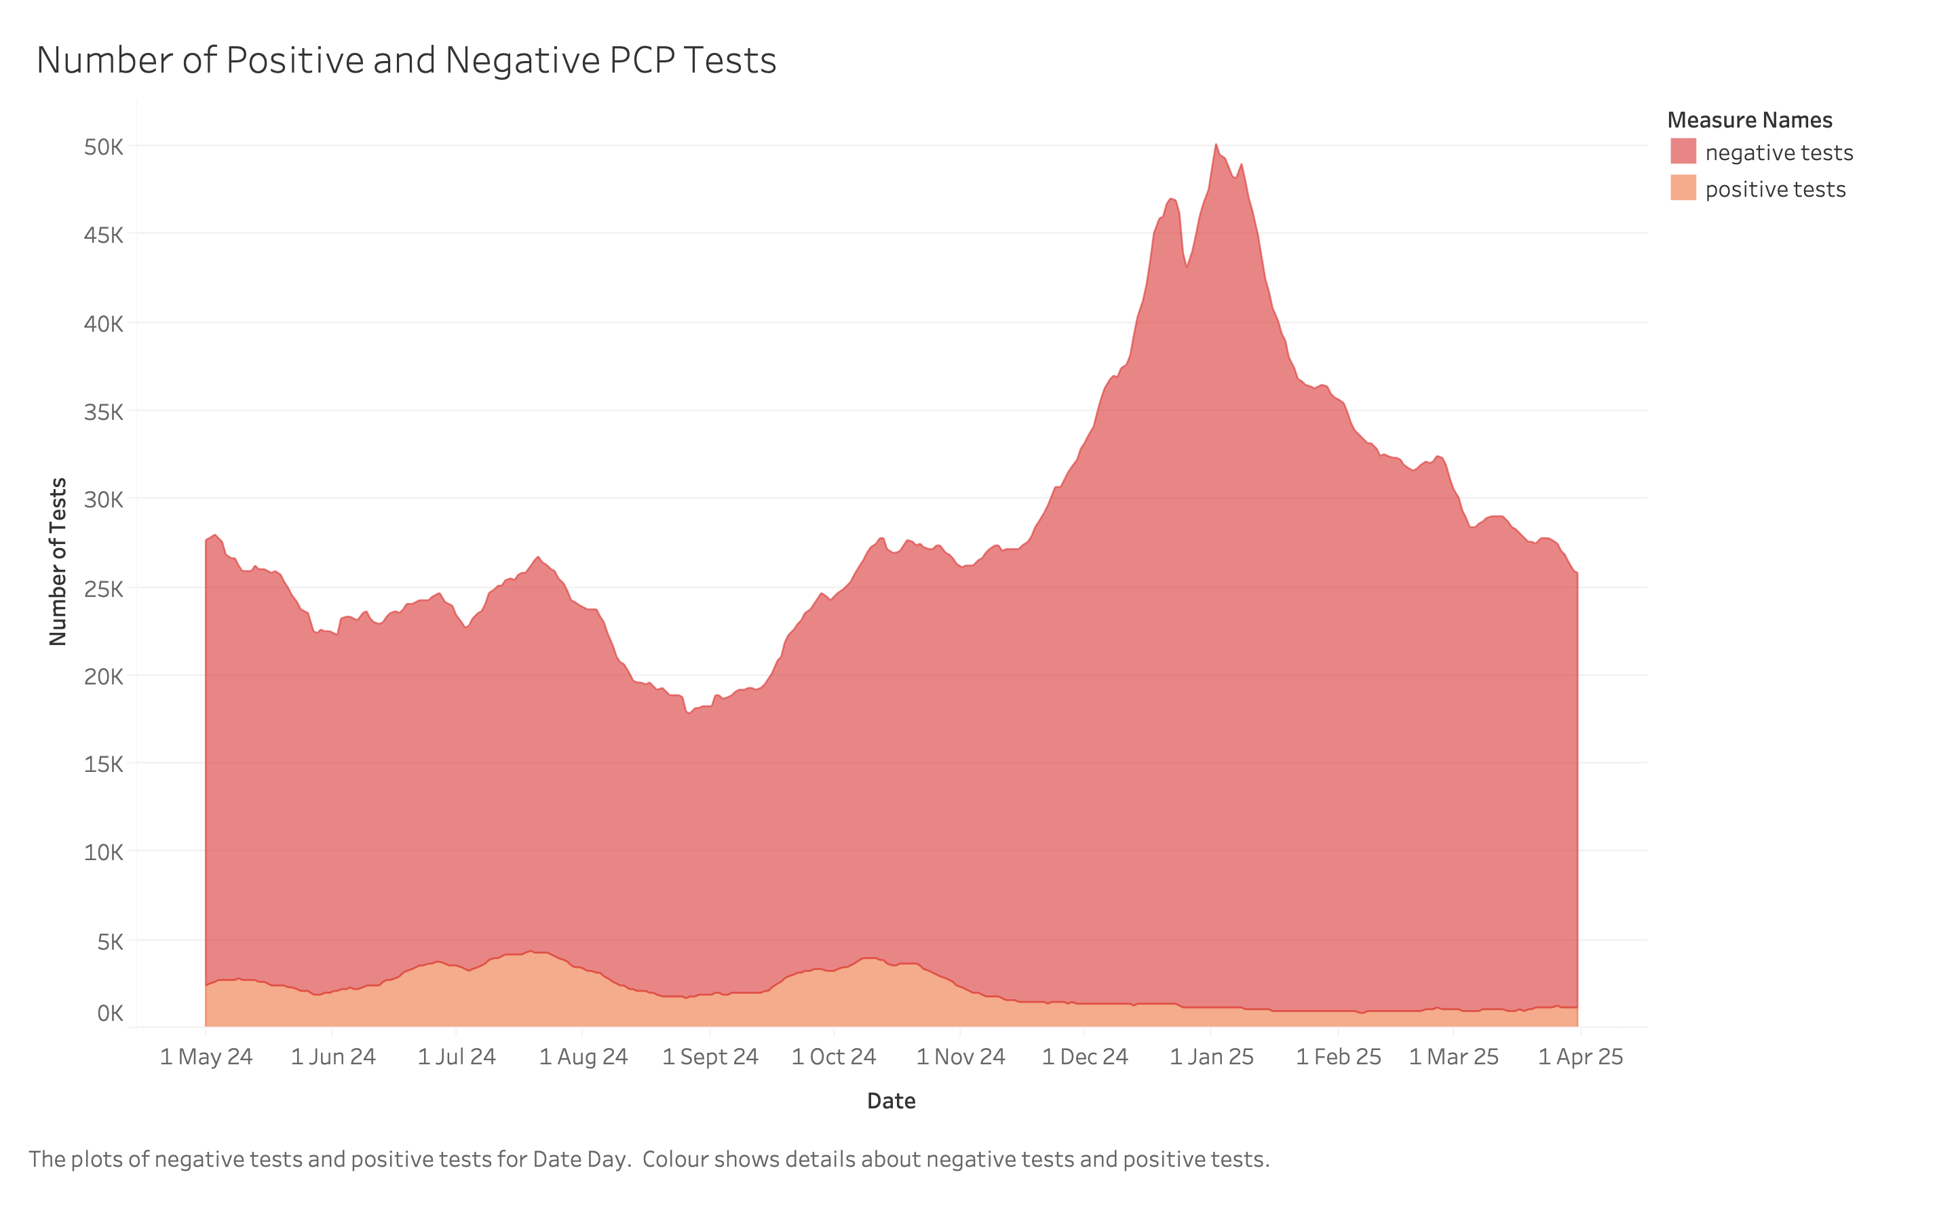
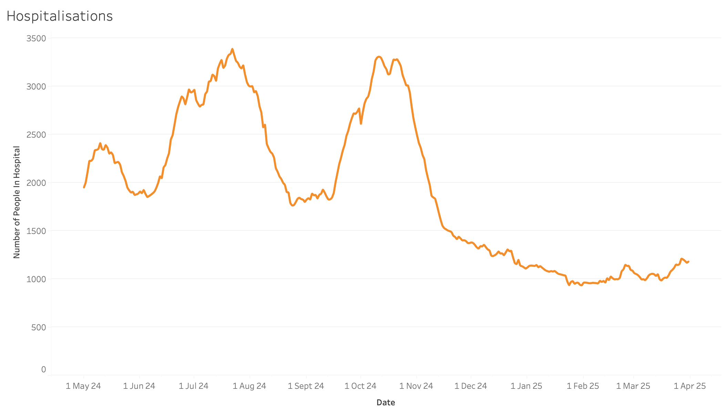
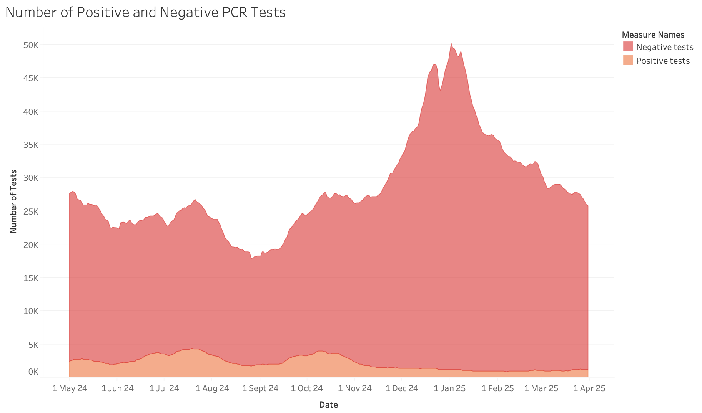
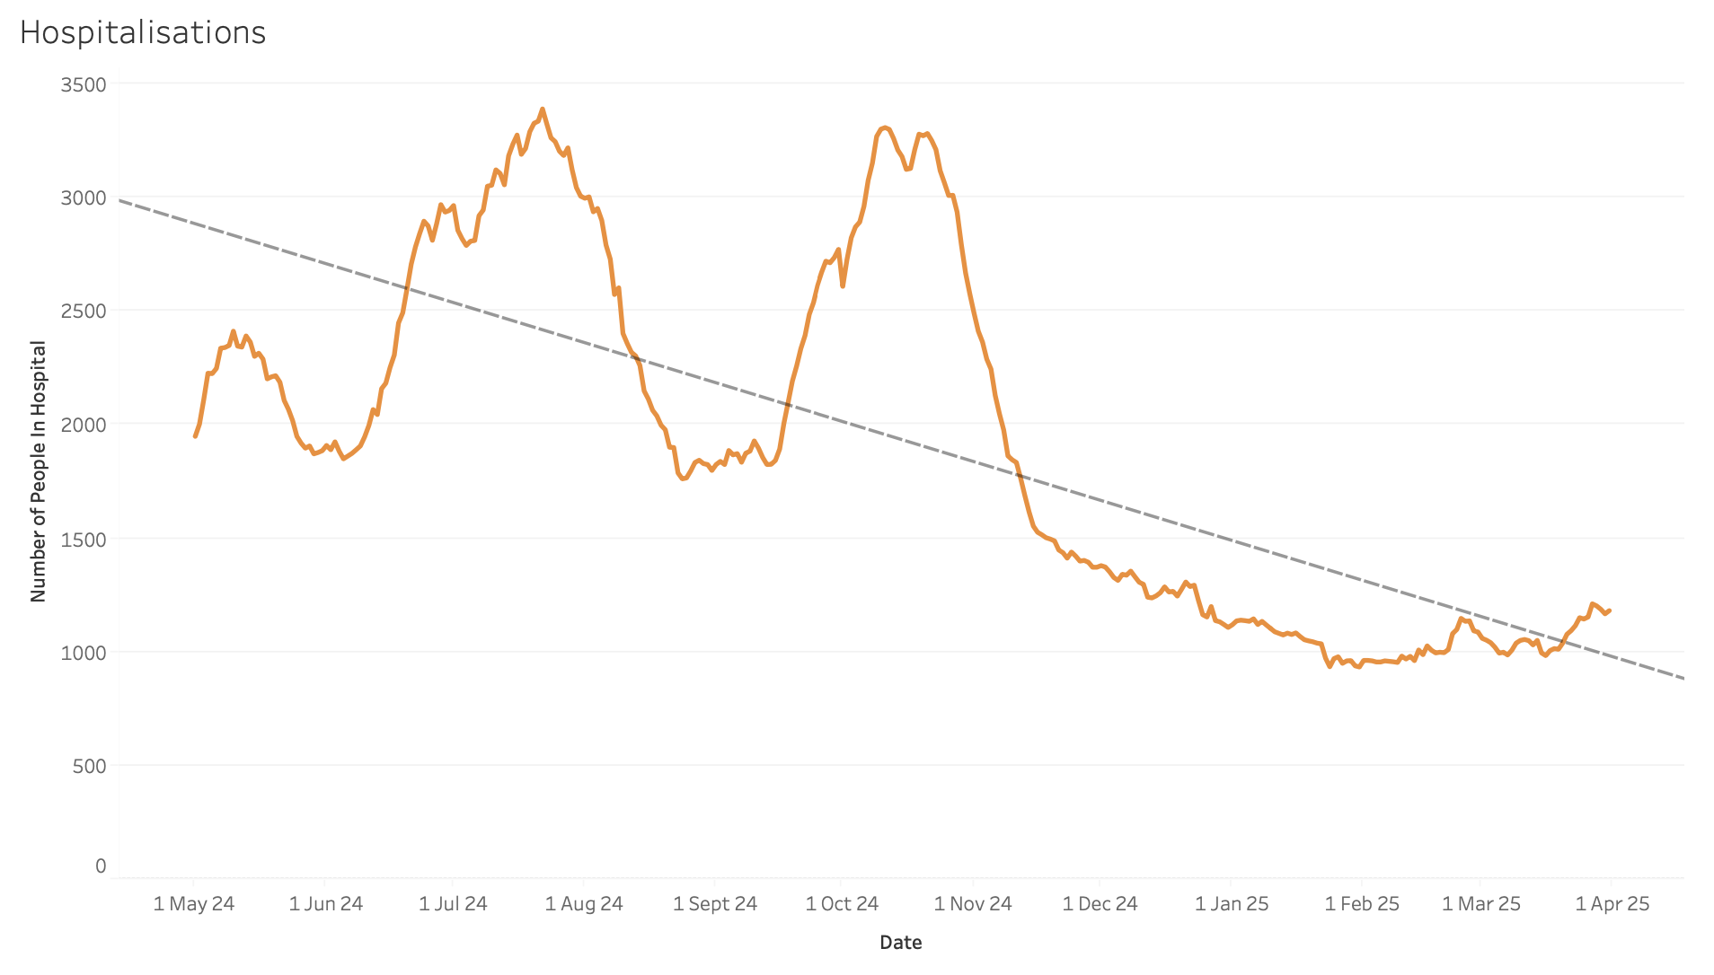
Dataset Statistics
Number of individuals who received a PCR test, categorised by test result.
Number of individuals in a hospital for Covid related reasons.
Observations:
Overall tests are typically around 25,000 per week before a peak of 50,000 around New Year’s Day.
Overall tests and positive tests do not correlate, but number of people in hospital and positive tests do.
A downward trend in the number of people in hospital is observed, with two peaks in late July and mid-October.
Notes:
In the area chart, "Number of tests" refers to the number of people tested in the previous 7 days, based on the reference date (the date of the 7-day window). Individuals are counted once per period, even if tested multiple times.

Slide 5
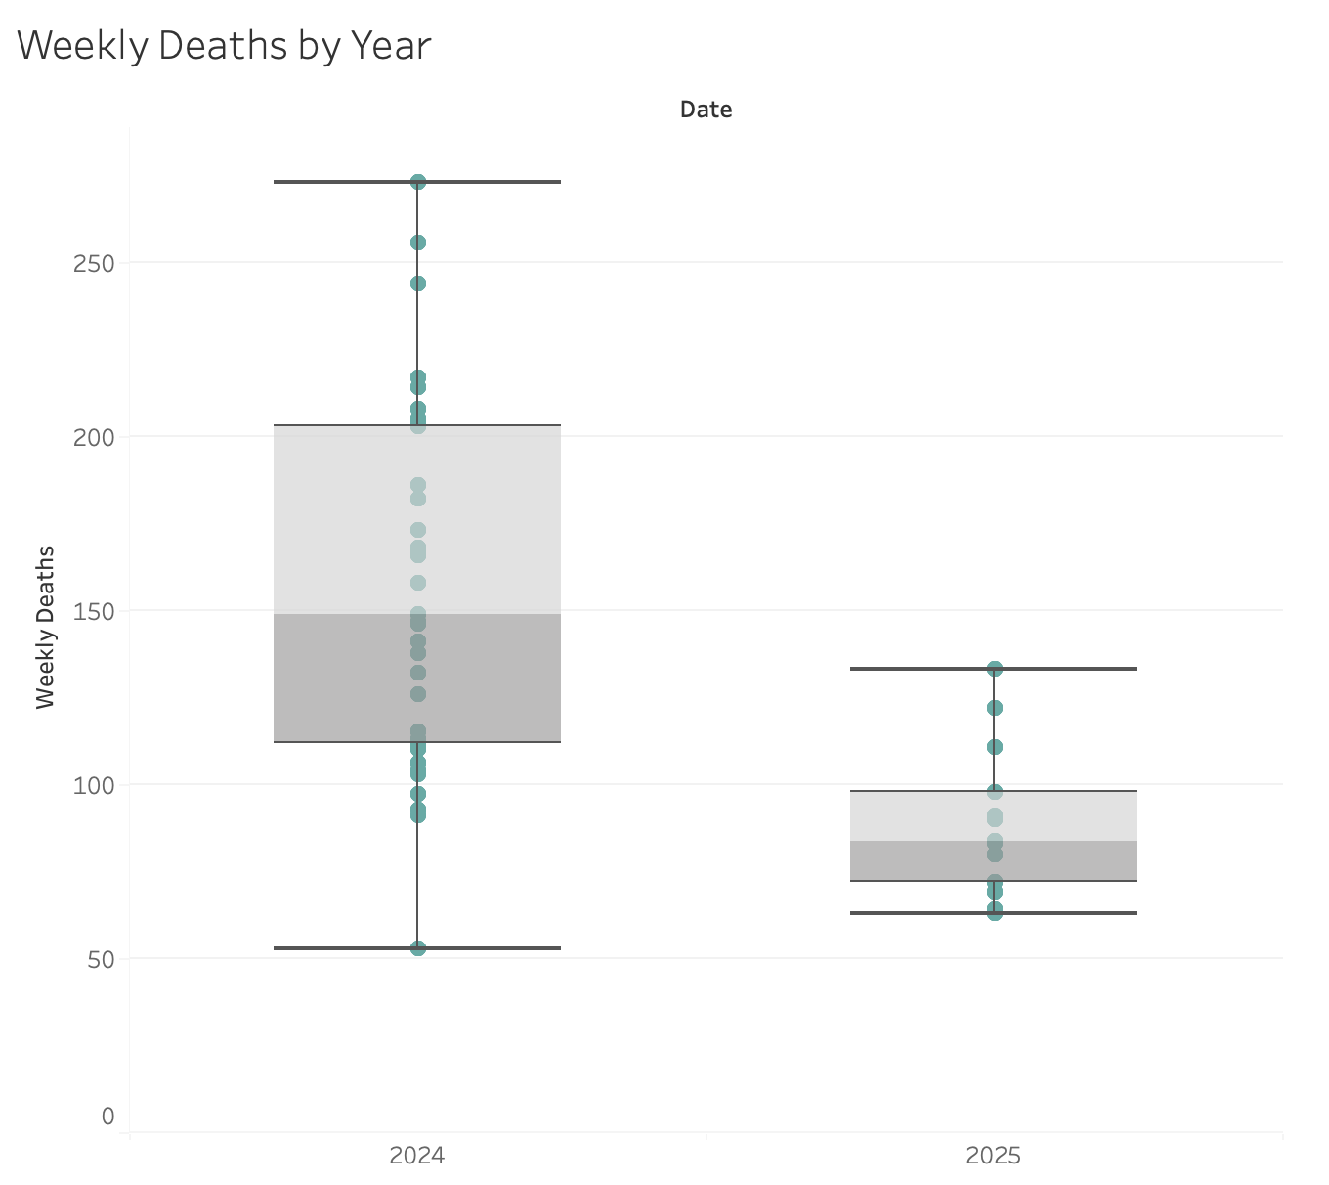
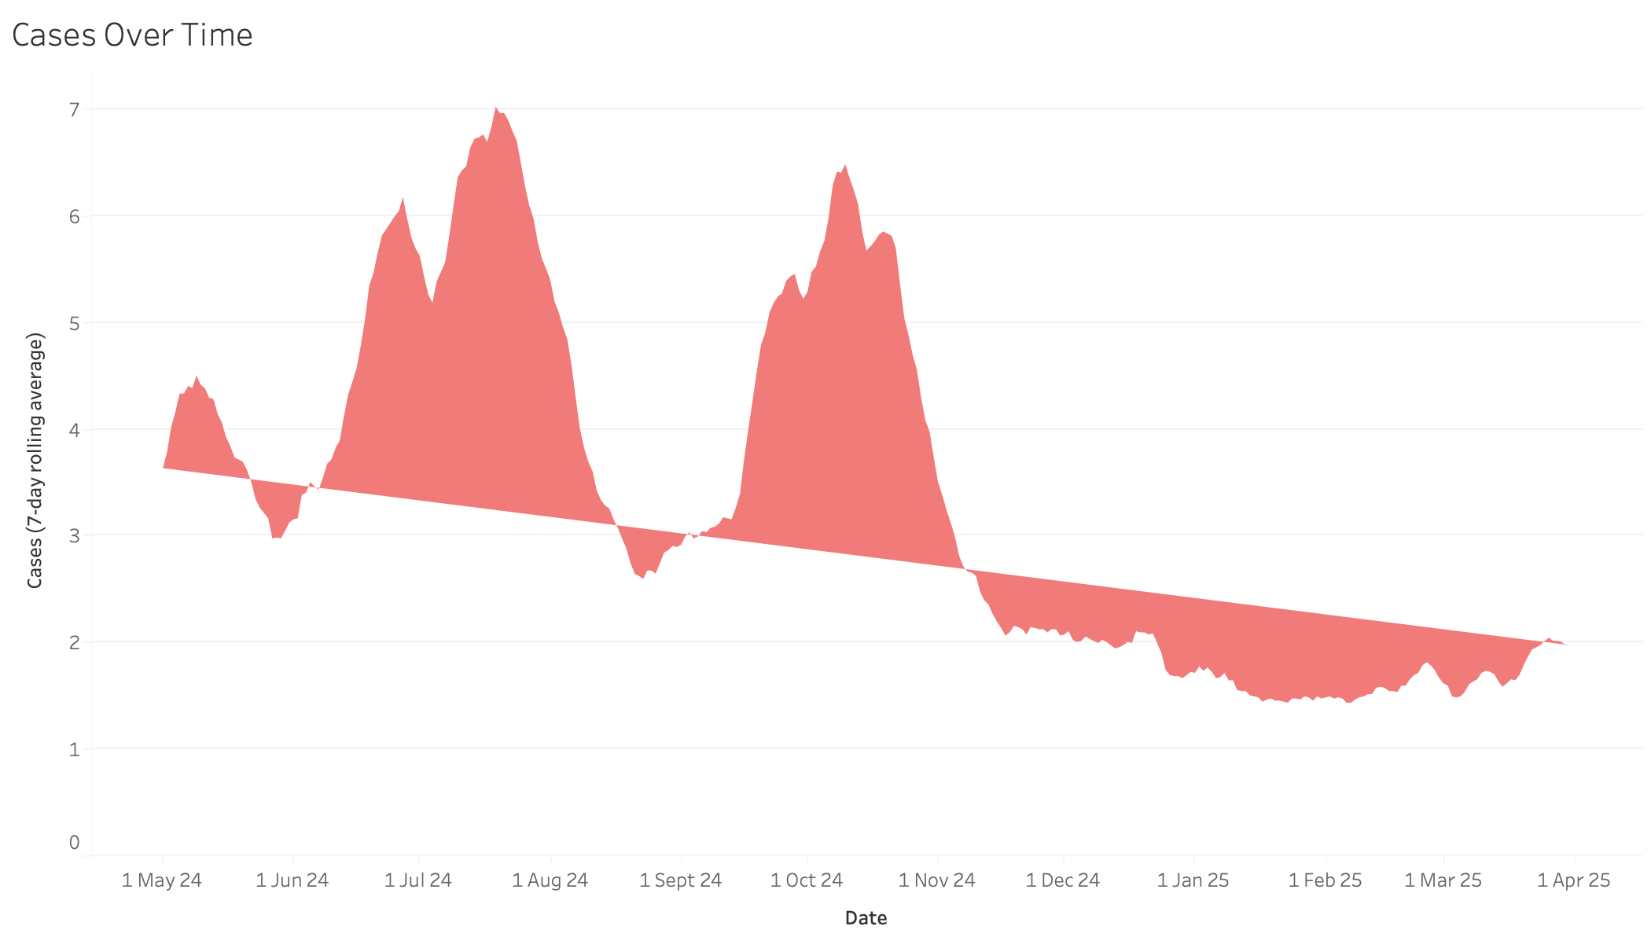
Dataset Statistics
Seven-day rolling average of reported cases over time. Shaded region represents case counts, relative to the trendline.
Box plots of weekly deaths, separated by year.
Observations:
The trendline indicates an overall decrease in the number of cases over time.
The chart displays two peaks in case counts – late July and mid October.
Weekly deaths had a higher average in ‘24 than in ‘25, with significantly greater variability in ‘24.*
Notes:
* Expanding on the last observation; the 2024 data covers a 7-month period from May to December, while the 2025 data includes only 3 months, from January to March. As a result, comparing data between the two years may not provide a fair assessment. Therefore, year is not considered in the main analysis of objectives.

Slide 6
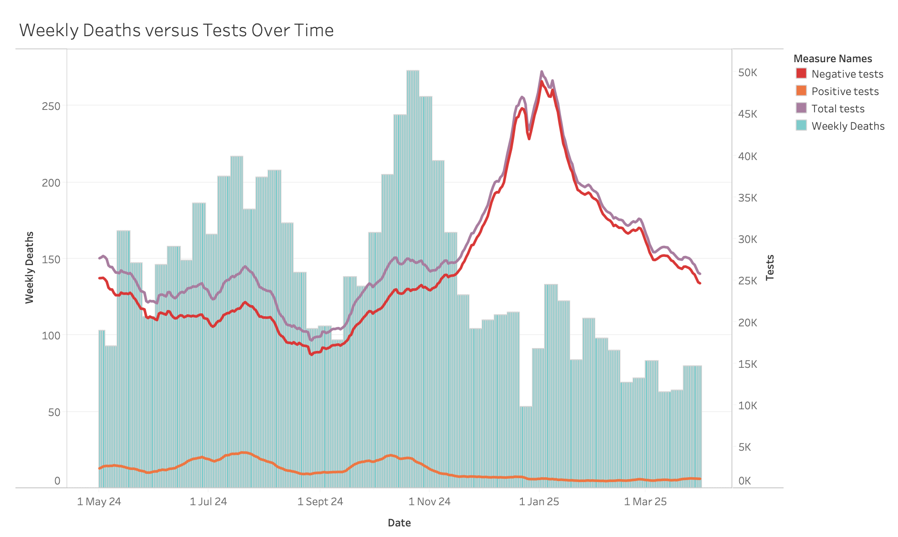
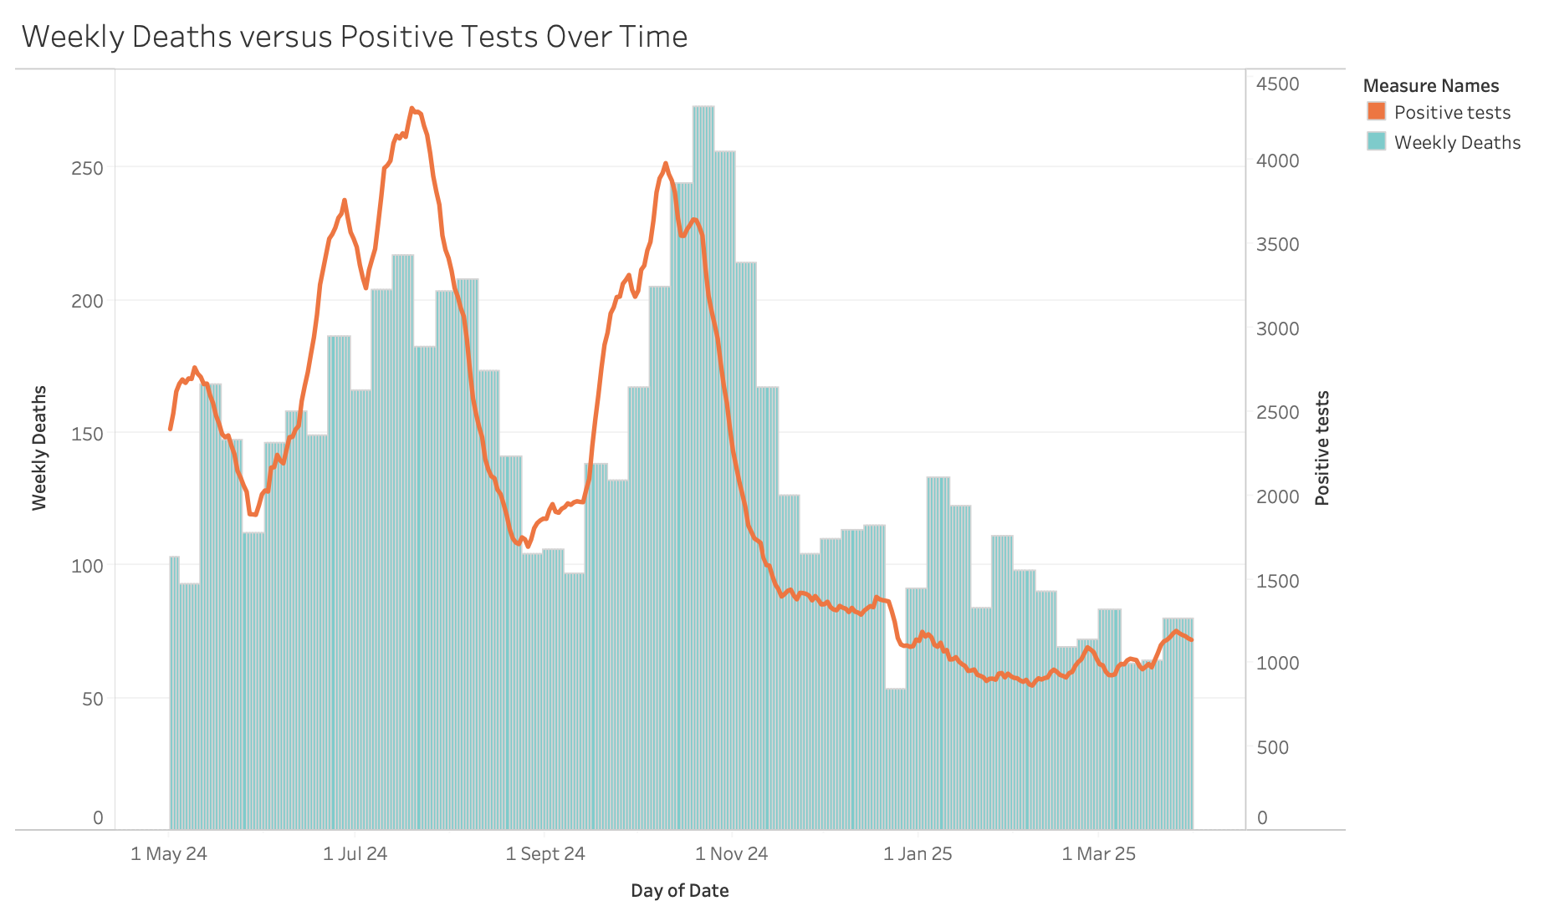
Analytics and Visualisations
Objective 1: To find which factors most strongly predict weekly COVID-19 deaths in the UK between May 2024 and March 2025.
Total and negative tests show weak positive correlation with deaths prior to November.
After November, test numbers peak sharply, but deaths do not increase correspondingly.
Positive tests correlate with weekly deaths, with a clear lag seen in late October to early November.
Notes:
These illustrations are combination charts, they have dual axis.

Slide 7
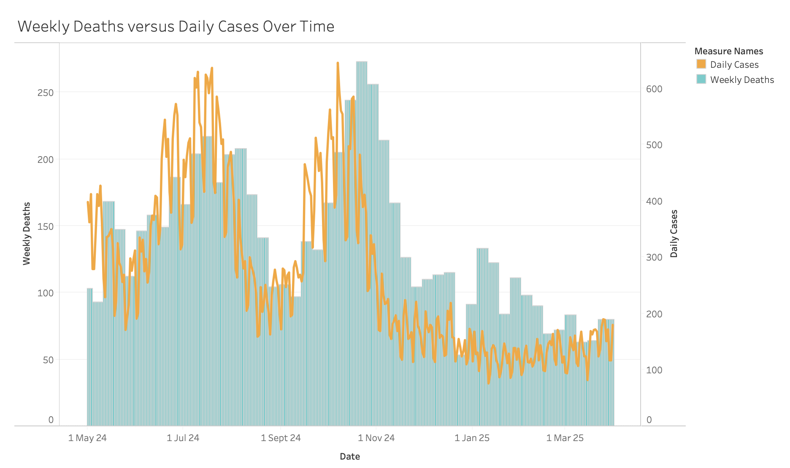
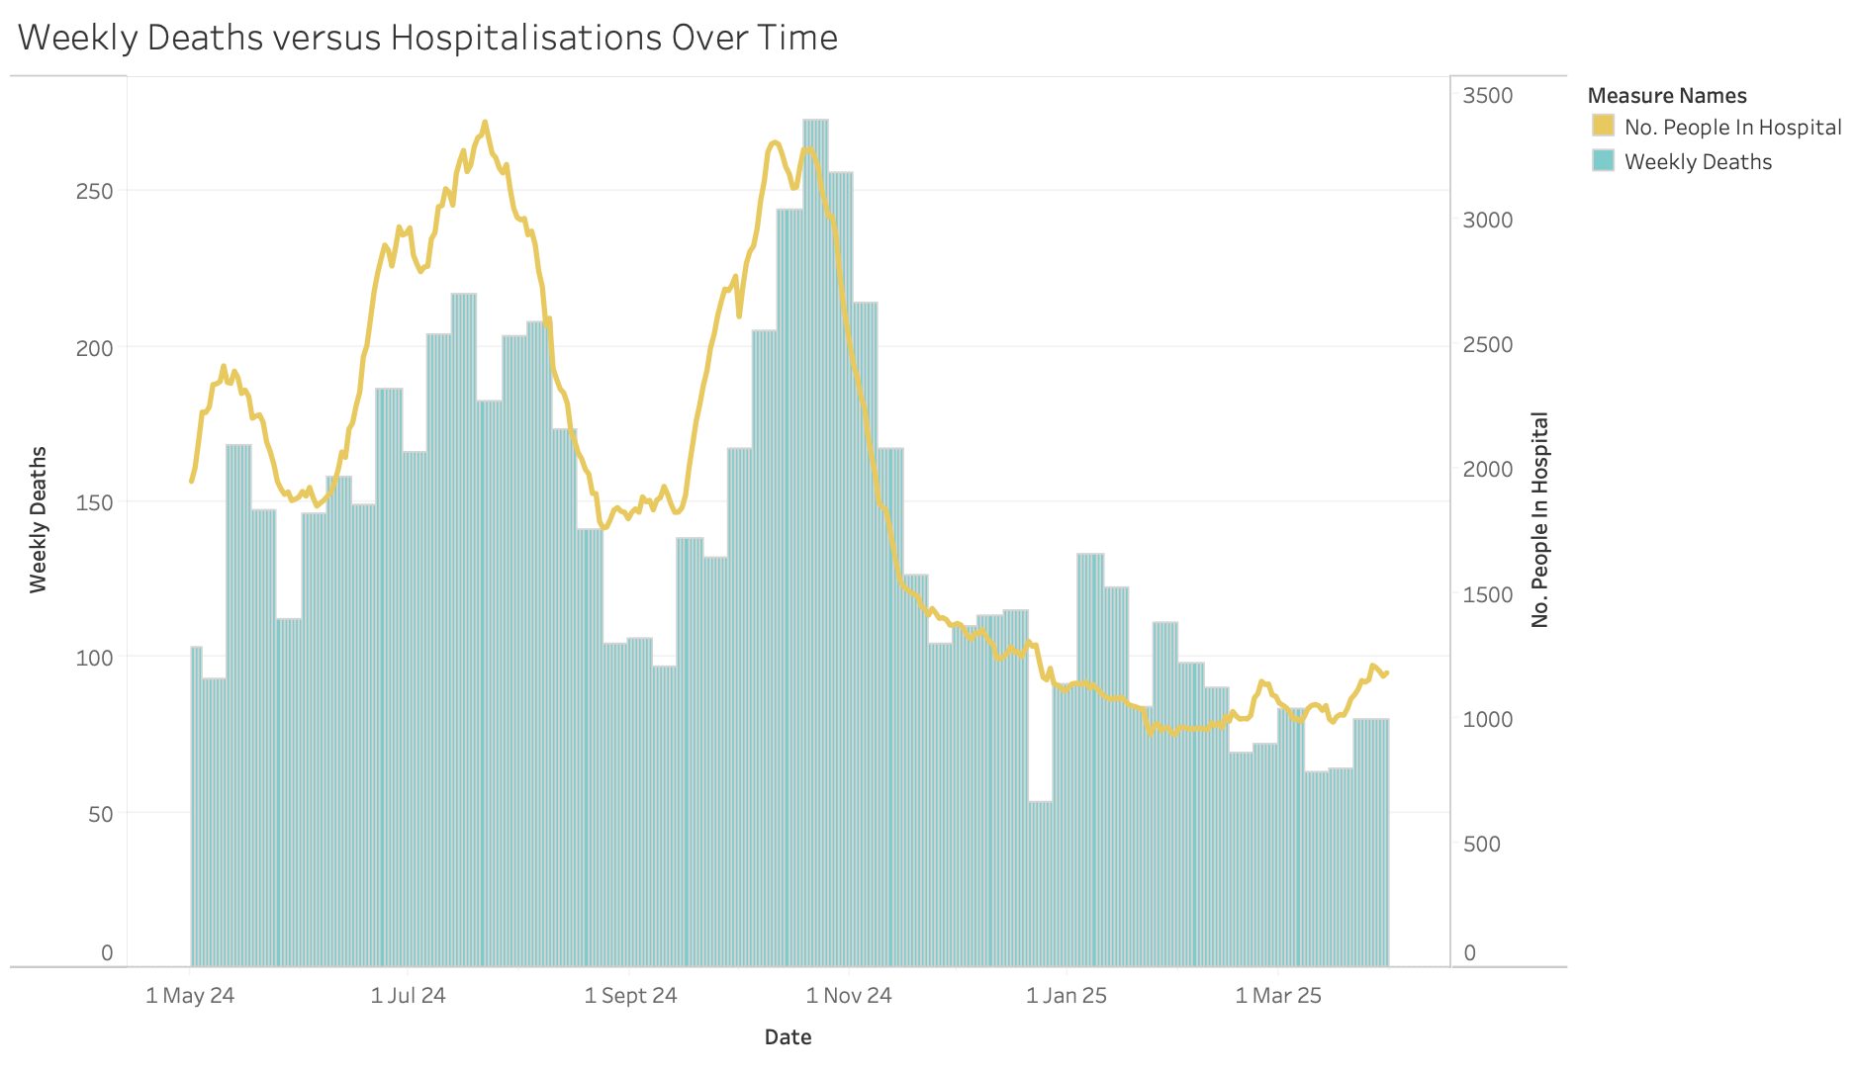
Analytics and Visualisations
Objective 1: To find which factors most strongly predict weekly COVID-19 deaths in the UK between May 2024 and March 2025.
Daily cases evidently correlate with weekly deaths despite the fluctuations.
This positive correlation is lagged, most clearly seen in late October to early November.
Weekly deaths also correlate with hospitalisations, though with a smaller time lag.
Notes:
These illustrations are combination charts, they have dual axis.

Slide 8
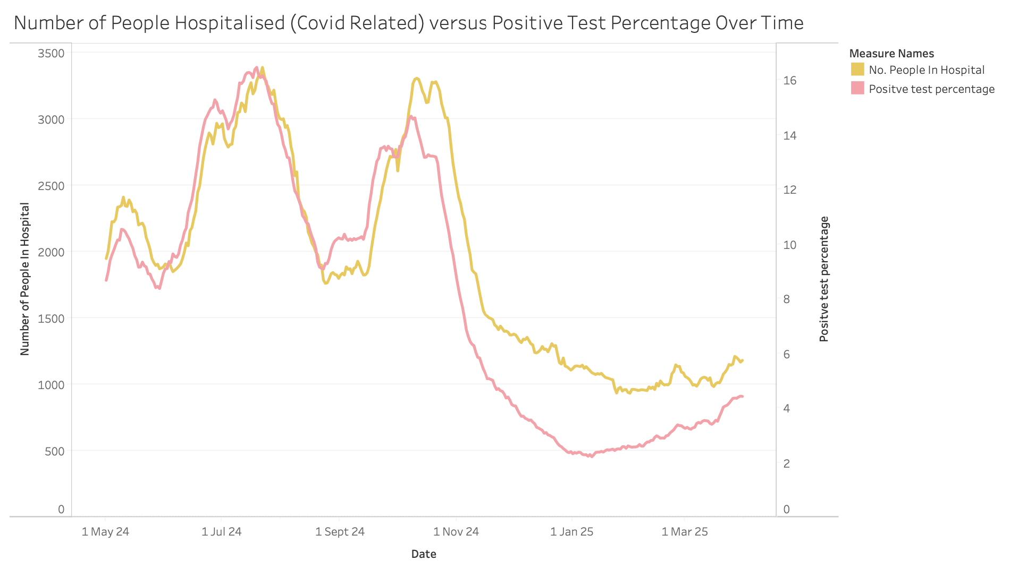
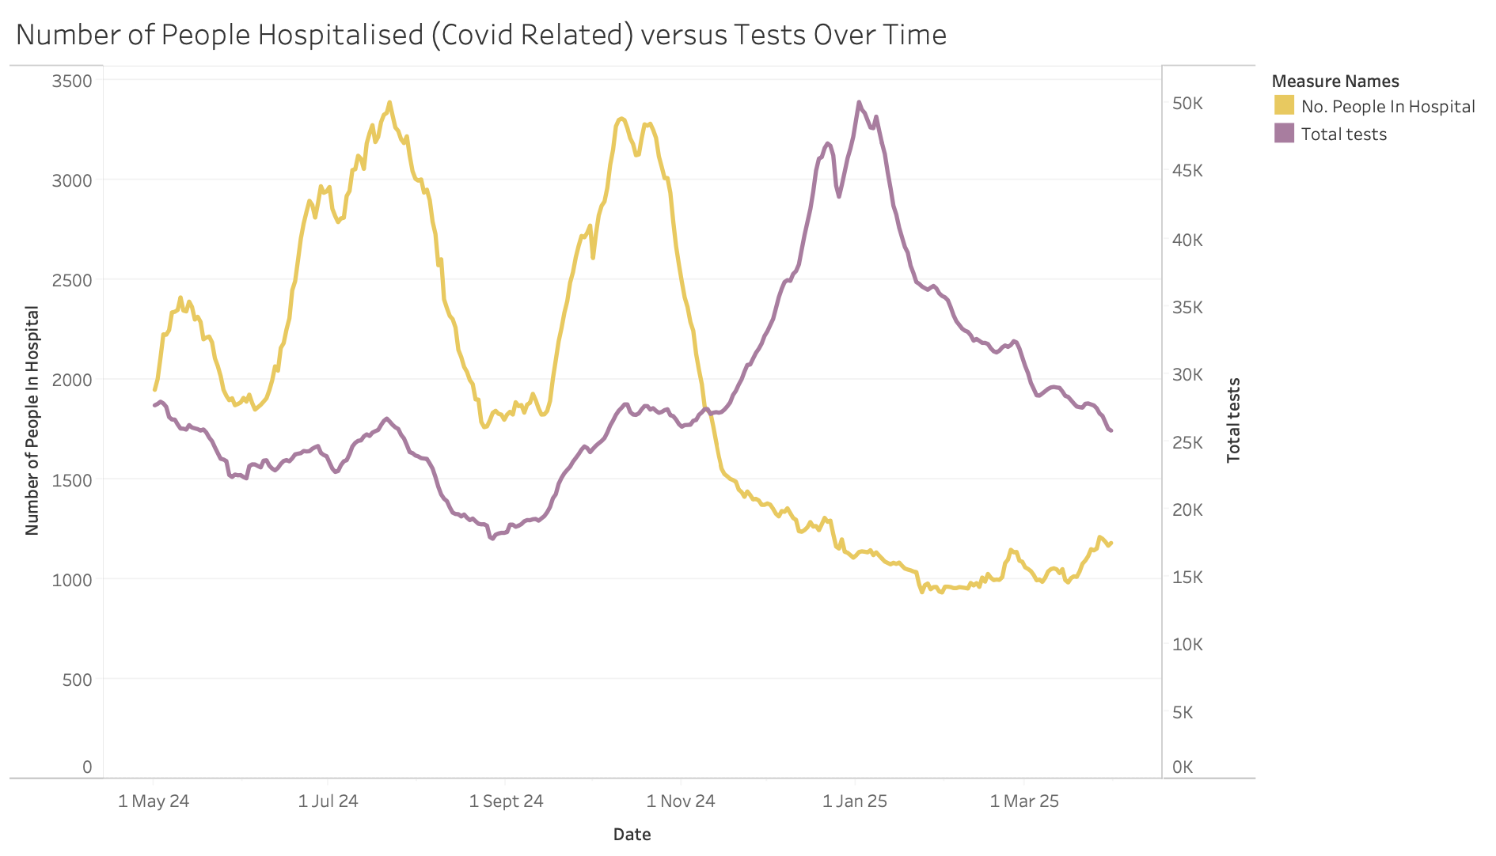
Analytics and Visualisations
Objective 2. To find which factors most strongly predict upcoming hospital strain during this period.
Initially, the positive test percentage shows a strong positive correlation with hospitalisations.
However, after November, the positive test percentage falls significantly below the number of people in hospital.
There is little to no correlation observed between the total number of tests conducted and hospitalisation figures.

Slide 9
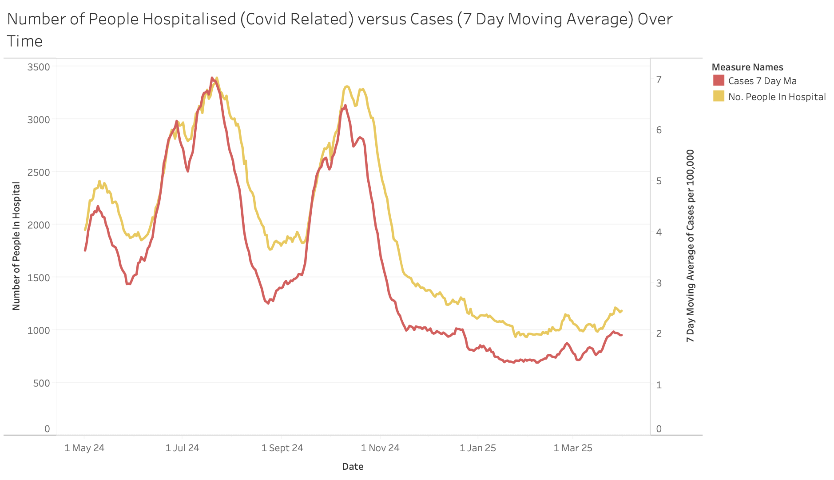
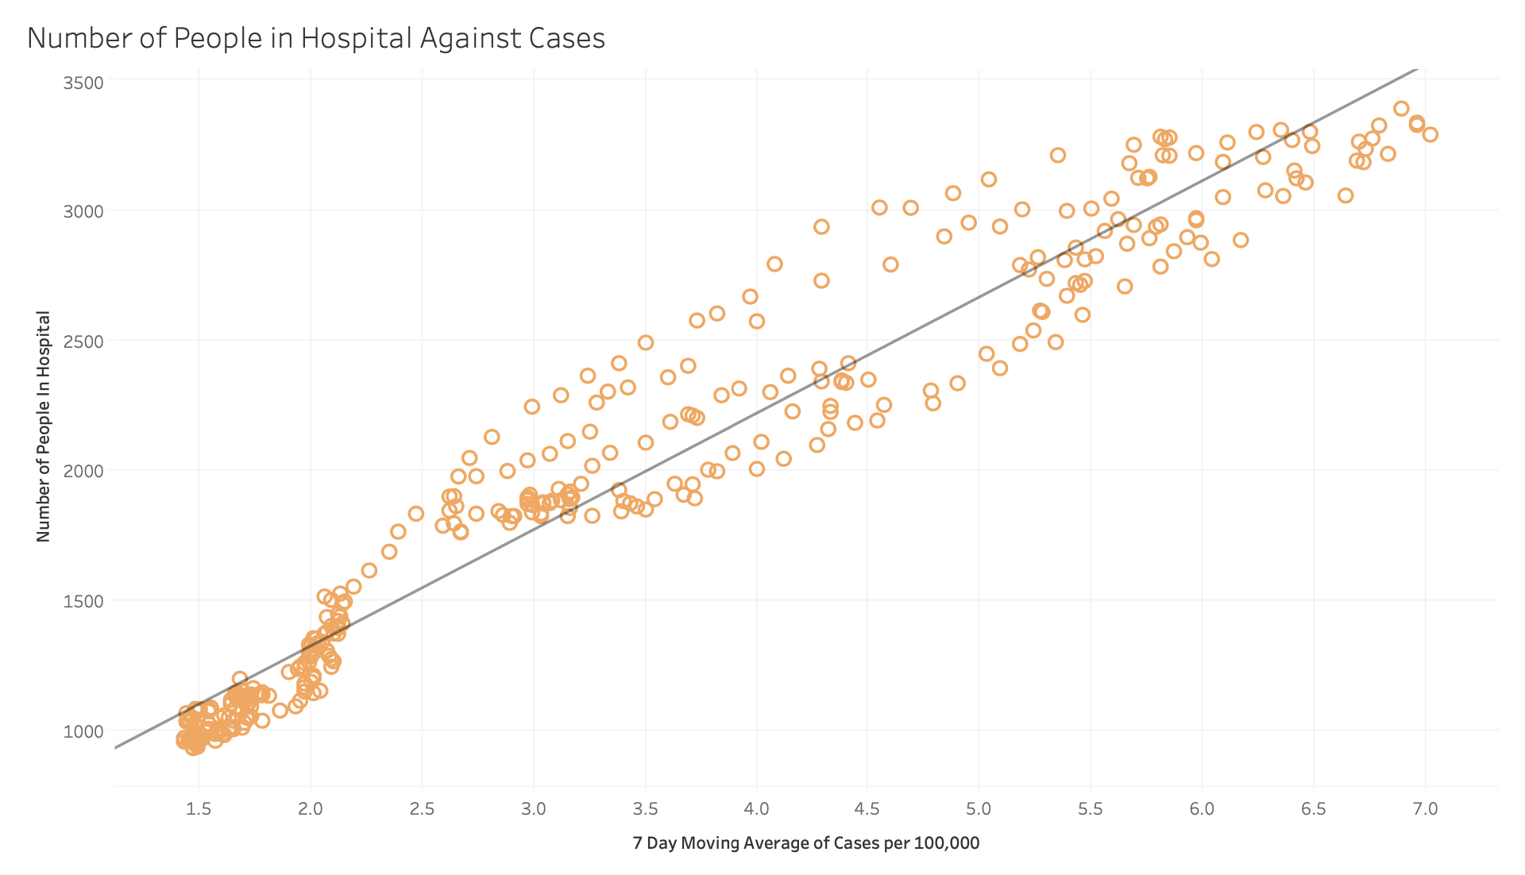
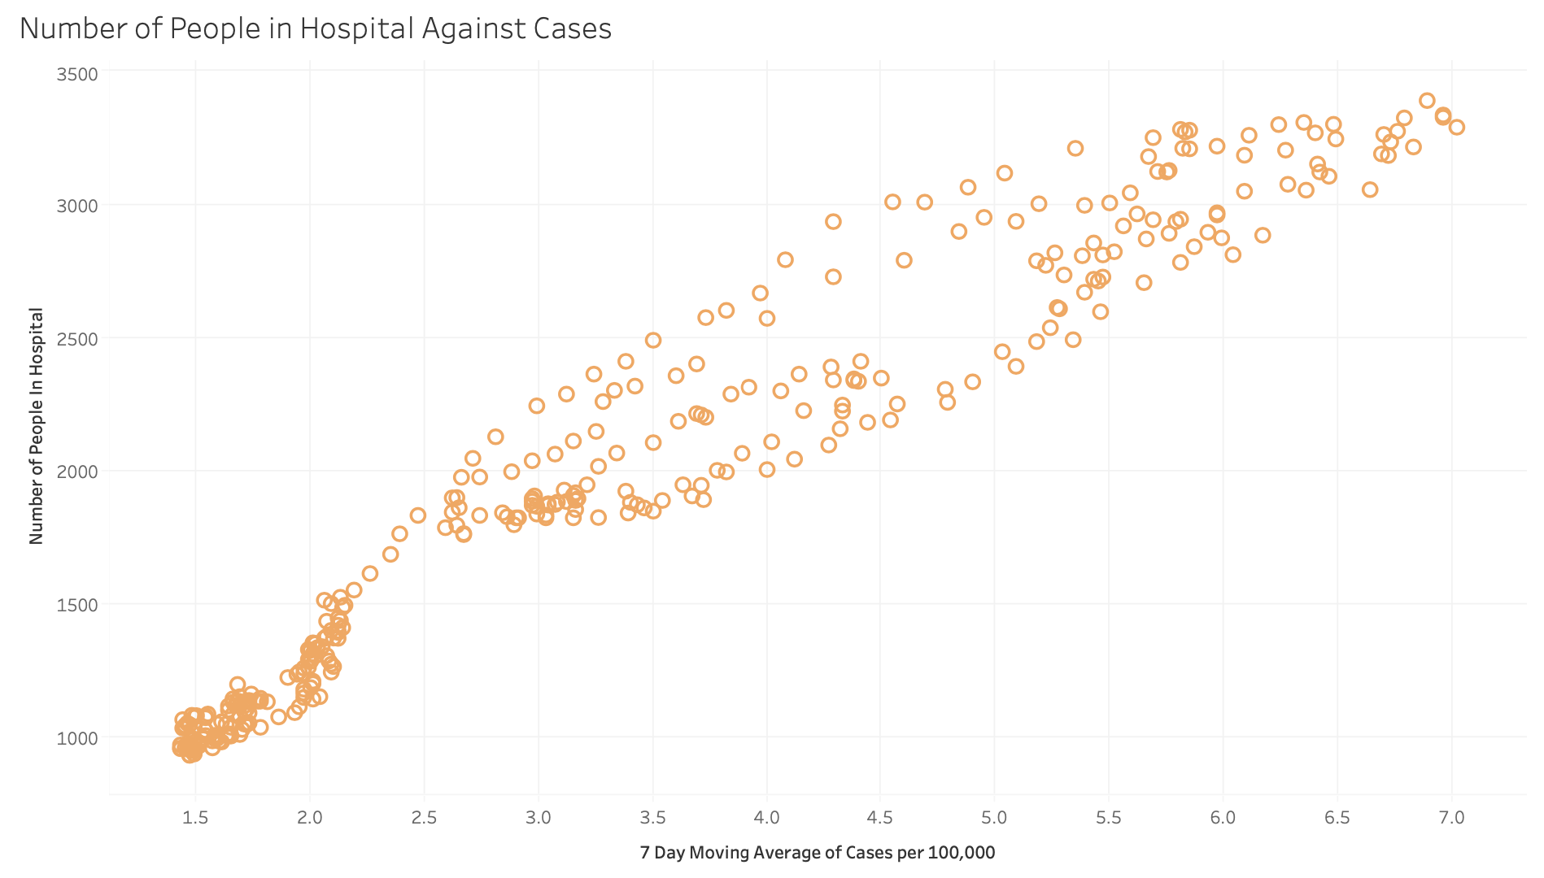
Analytics and Visualisations
Objective 2. To find which factors most strongly predict upcoming hospital strain during this period.
First graph shows that hospitalisations and the 7-day moving average of cases are positively correlated with a time lag.
Second graph further shows the strong positive correlation between the two variables, even when the time lag is not explicitly shown.

Slide 10
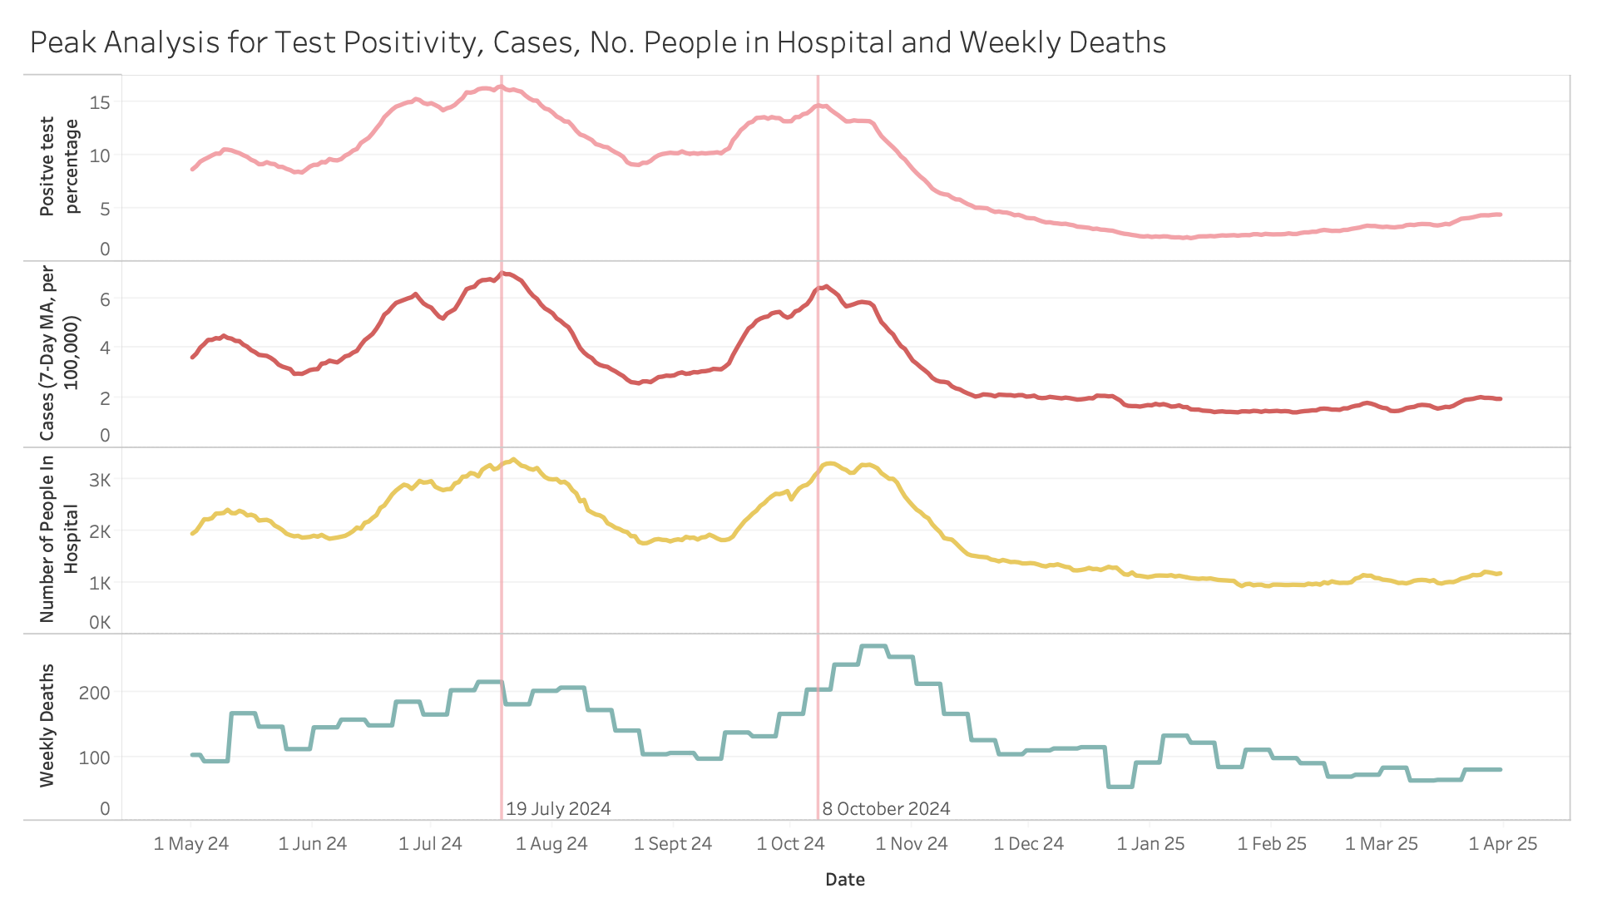
Analytics and Visualisations
3. To find whether peaks in test positivity always coincide with peaks in cases, hospitalisations, and deaths.
Two main peaks for positive test percentage – 19 July 2024 and 8 October 2024.
Peaks for cases (7-day rolling average) and number of people in hospital roughly match the peaks for test positivity.
Deaths roughly match for the first peak but lag a couple of weeks behind at the second peak.
Notes:
This is a faceted line chart with the peak compared via a vertical line.

Slide 11
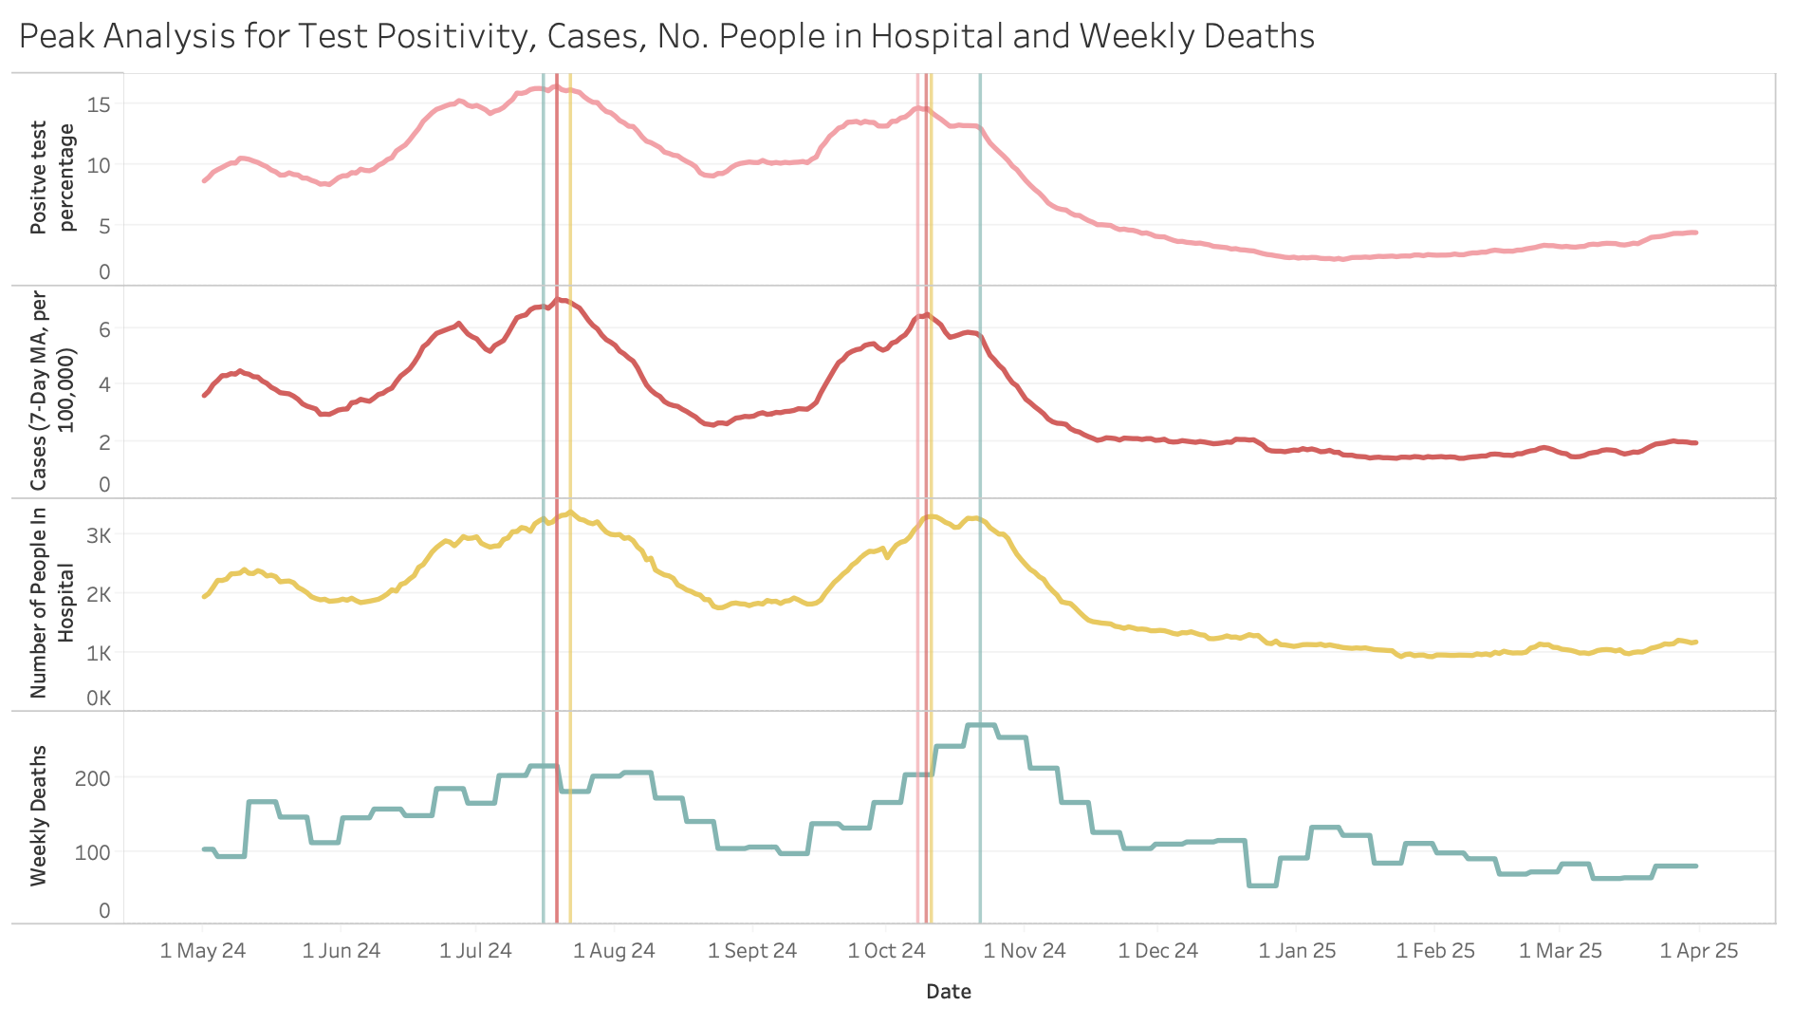
Analytics and Visualisations
3. To find whether peaks in test positivity always coincide with peaks in cases, hospitalisations, and deaths.
All 4 variables first peak within 7 days of each other (16 July – 22 July).
In the second peak, test positivity, cases and people in hospital peak within 4 days of each other (8 October – 11 October).
Deaths lag by 1-2 weeks at the second peak.
Notes:
This is a faceted line chart with each peak compared via a vertical line.

Slide 12
Analytics and Visualisations
Objective 4. To explore how the relationship between test positivity and hospitalisations changed over time, possibly indicating a shift in disease severity.
Positive test percentage and hospitalisations showed alignment early on (May-Nov 2024).
Diverged after November - low positive test rate but a substantial number of hospitalisations.
Implies an increase in disease severity but could be caused by lag from the October peak.

Slide 13
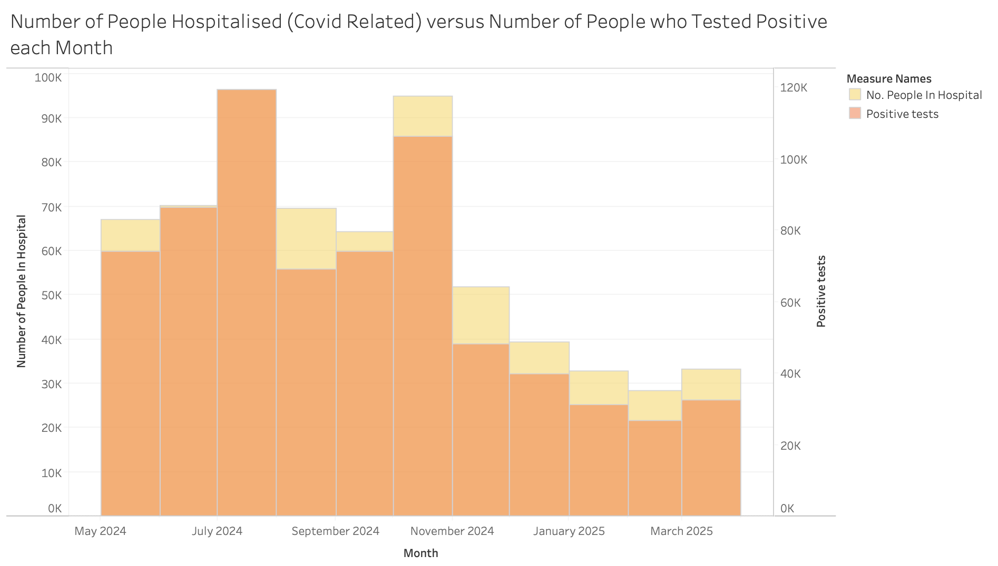
Analytics and Visualisations
Objective 4. To explore how the relationship between test positivity and hospitalisations changed over time, possibly indicating a shift in disease severity.
Number of positive tests and number of people in hospitals show a strong positive correlation.
The correlation is marginally stronger in the first months of this period – particularly in June and July 2024.
Implies a minor increase in disease severity but could be caused by lag from the October peak.

Slide 14
How Our Findings Compare to Media Narratives
Objective 1. To find which factors most strongly predict weekly COVID-19 deaths in the UK between May 2024 and March 2025.
Objective 2. To find which factors most strongly predict upcoming hospital strain during this period.
Our Findings:
Number of cases strongly predicted Covid related deaths and hospitalisations.
Number of individuals in hospital for Covid related reasons strongly predicted Covid related deaths.
Total number of tests taken did not have a correlation to deaths or number of people in hospital.
Media Narratives & Other Findings:
“Positive test data were in excellent agreement with subsequent deaths.” [1]
UKHSA’s projections indicated that increases in hospital admissions were associated with rises in deaths. [2]
People with Covid symptoms no longer take Covid tests [3]. Only high people at high risk of being seriously ill can get free Covid tests now [4], hence skewing results and explaining the lack of correlation.
Notes:
Due to the limited media focus on COVID-19 metrics during 2024-2025, comparing our findings requires drawing upon some reports and analyses from earlier pandemic phases.
[1] https://www.news-medical.net/news/20210125/UK-COVID-19-death-to-case-ratio-increased-in-December-2020-say-researchers.aspx
[2] https://www.gov.uk/government/publications/consensus-statements-on-covid-19/emrg-medium-term-projections-for-covid-19-hospitalisations-and-deaths-31-august-2022
[3] https://www.bbc.co.uk/news/articles/c897qq0gxe2o
[4] https://www.nhs.uk/tests-and-treatments/covid-19-rapid-lateral-flow-test/

Slide 15
How Our Findings Compare to Media Narratives
Objective 3. To find whether peaks in test positivity always coincide with peaks in cases, hospitalisations, and deaths.
Our Findings:
Peaks in test positivity coincided with peaks in cases and hospitalisations.
Peaks in test positivity coincided with peaks in deaths, but with a lag of around 2 weeks.
Media Narratives & Other Findings:
Studies show that peaks in test positivity do coincide with peaks in cases and hospitalisations. [5]
“Peaks in deaths from COVID-19 typically are seen approximately three weeks after peaks in infections.” [6]
Notes:
Due to the limited media focus on COVID-19 metrics during 2024-2025, comparing our findings requires drawing upon some reports and analyses from earlier pandemic phases.
[5] https://www.ons.gov.uk/peoplepopulationandcommunity/healthandsocialcare/conditionsanddiseases/articles/coronaviruscovid19latestinsights/Overview
[6] https://cy.ons.gov.uk/peoplepopulationandcommunity/healthandsocialcare/conditionsanddiseases/articles/moreinformationondatasourcesrelatedtocoronaviruscovid19/2020-12-11

Slide 16
How Our Findings Compare to Media Narratives
Objective 4. To explore how the relationship between test positivity and hospitalisations changed over time, possibly indicating a shift in disease severity.
Our Findings:
Results indicated a slight increase in disease severity in late 2024.
This finding was based on positive test percentage and number of positive tests, but we have established that most people with Covid symptoms no longer take Covid tests.
The data leading to our finding is therefore likely misleading.
Media Narratives & Other Findings:
At the end of 2024, a new Covid variant, XEC, was tipped to “become the dominant subvariant over the winter” [7].
XEC did become the dominant strain but, “There is no evidence that XEC causes different symptoms or more severe disease than other recent strains.” [8]
Notes:
[7] https://www.bbc.co.uk/news/articles/c1jddenj5p5o
[8] https://www.yalemedicine.org/news/3-things-to-know-about-xec-the-latest-covid-strain

Slide 17
Conclusions – Objective 1
To find which factors most strongly predict weekly COVID-19 deaths in the UK between May 2024 and March 2025.
Number of Covid cases and hospitalisations were the best indicators of weekly Covid deaths.
Both showed a strong correlation, lagged by 1-2 weeks.
Total number of tests did not predict deaths.
The media narratives agreed with these findings.
Combination charts of cases and hospitalisations versus deaths over time, copied from slide 11.

Slide 18
Conclusions – Objective 2
To find which factors most strongly predict upcoming hospital strain during this period.
Number of Covid cases (7-day moving average) was the strongest predictor of upcoming hospitalisations.
Positive test percentage also showed correlation.
Total number of tests did not predict upcoming hospitalisations.
The media narratives agreed with these findings.
Line charts of cases and tests versus number of people in hospital over time, copied from slide 13 & 14.

Slide 19
Conclusions – Objective 3
To find whether peaks in test positivity always coincide with peaks in cases, hospitalisations, and deaths.
All three variables were shown to have peaks coinciding with the peaks of test positivity – mid July and early October.
Cases, hospitalisations and test positivity had near identical peaks.
Deaths lagged by 2 weeks at the second peak.
Media narratives agreed but an ONS study stated that deaths follow with a lag of approximately 3 weeks.
Faceted line chart with each peak compared, copied from slide 16.

Slide 20
Conclusions – Objective 4
To explore how the relationship between test positivity and hospitalisations changed over time, possibly indicating a shift in disease severity.
Positive test percentage and hospitalisations showed alignment at first but diverged after November.
Hospitalisations went higher than positive test percentage, implying an increase in disease severity.
Researching media narratives highlighted that Covid testing is no longer common.
Therefore, the data leading to our finding is likely misleading.

